Slide 1

Android Application
User Interface

Slide 2
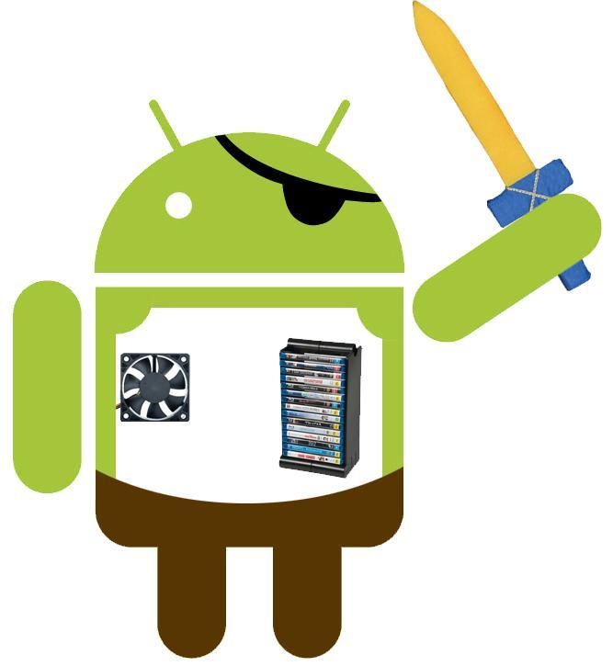
Anatomy of Android application
Broadcast Receivers
Intents
Activities
Services
Views
Content Providers

Slide 3
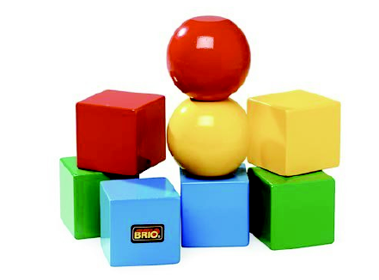
Application building blocks
AndroidManifest
    general configuration for your application
    contains all component definitions of your appication
Activities*
    application presentation layer
    single, focused things that user can do
    kind of “screen”
    layout and display information with Fragments
    and Views
    respond to user actions
    well-defined lifecycle

Slide 4

Application building blocks
Services
    run without UI
    update data sources and Activities
    trigger Notifications
    used to perform long running tasks
    w/o user interaction
Content Providers
    shareable persistent data storage
    across application boundaries
    e.g. Contacts, MediaStore, Settings

Slide 5
Application building blocks
Intents
    interapplication message-passing framework
    used to request an action be performed on a particular piece of data
    kind of absolute and relative links
Broadcast Receivers
    listen for Intents that match the criteria
    e.g. SMS message
App Widgets
    Visual application components that are added to the home screen

Slide 6
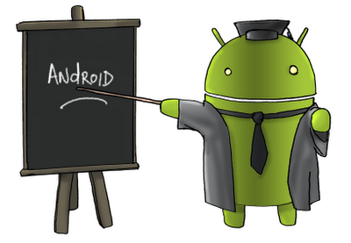
Android UI fundamentals

Slide 7
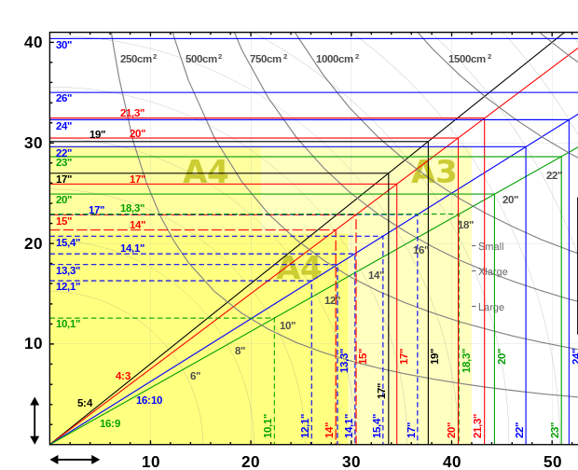
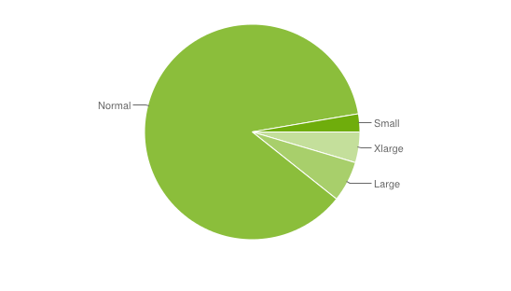
Android UI fundamentals
Screen size
    actual physical size, measured as the screen's diagonal
    2.55”, 3.2”, 4.0”, 10.1”, ...
    Android groups into four generalized sizes:
      Small
      Normal
      Large
      Xlarge

Slide 8
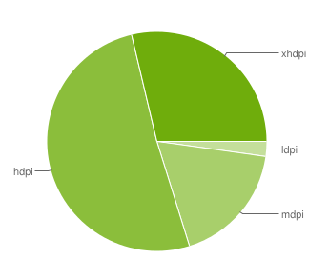
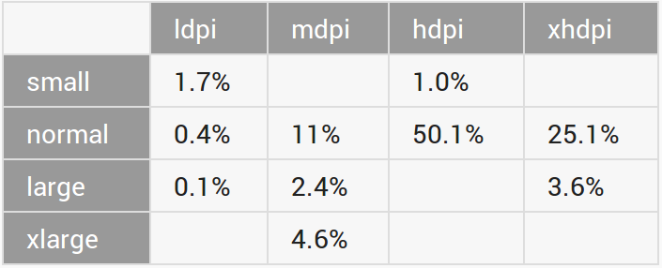
Android UI fundamentals
Screen density
  quantity of pixels within a physical area of the screen (dots per inch, dpi).
  "low" density screen has fewer pixels
  Android groups actual screen densities into four generalized densities:
    Low (ldpi, 120)
    Medium (mdpi, 160)
    High (hdpi, 240)
    Extra high (xhdpi, 320)

Slide 9
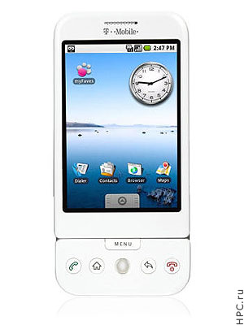
Android UI fundamentals
Density-independent pixel (dp)
  virtual pixel unit to express layout dimensions or position in a density-independent way
  equivalent to one physical pixel on a 160 dpi screen
  px = dp * (dpi / 160)
  system transparently handles any scaling of the dp units

Slide 10
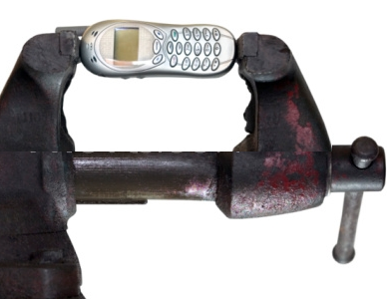
Android UI fundamentals
Generalized size and density
  Applications should be concerned only with generalized screen size and density groups
  Each generalized size and density spans a range of actual screen sizes and densities
  Screen-size buckets deprecated for Android >3.0
xlarge at least 960dp x 720dp
large at least 640dp x 480dp
normal at least 470dp x 320dp
small at least 426dp x 320dp

Slide 11
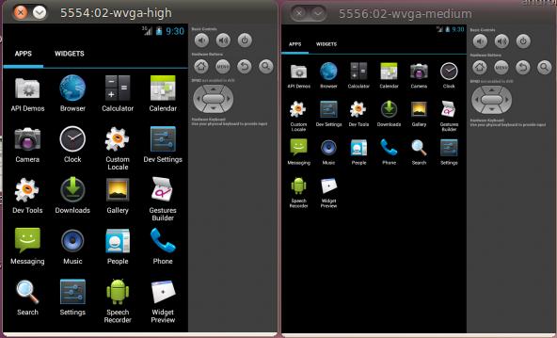
Resolution v. Generalized size
WVGA (800 x 480)
High-density (240 dpi)
Normal generalized size
WVGA (800 x 480)
Medium-density (160 dpi)
Large generalized size

Slide 12
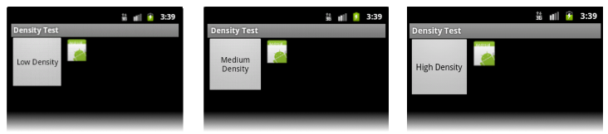
Density independence
Application preserves physical size of user interface elements when displayed on different densities
UI element appears physically larger on a low density screen without "density independence"

Slide 13
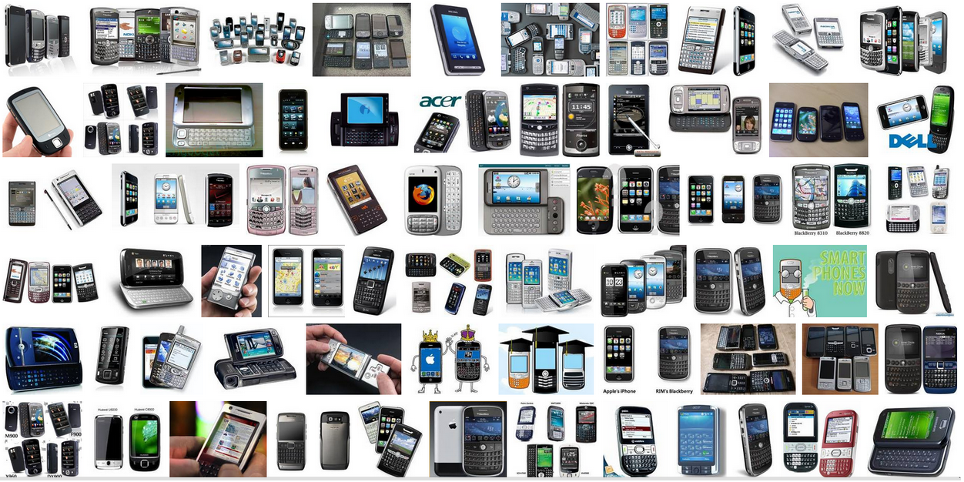
Why should I care?
To provide optimized resources for application to run on different hardware
Bitmap scaling can result in blurry or pixelated bitmaps. Use alternative bitmap resources for different densities instead
To maximize user experience (UX) for all devices
To make users believe application is designed for their devices - rather than simply stretched
Typically, alternative layouts for different screen sizes and alternative images for different densities

Slide 14




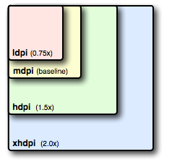
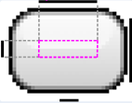
Alternative drawables
Almost every application should have alternative drawable resources for different screen densities
Follow the 3:4:6:8 scaling ratio between the four generalized densities
Nine-patch drawables
  standard PNG image that includes an extra 1-pixel-wide border to define the stretchable and static areas of the image, or padding lines

Slide 15

Best practices
Do not use hard-coded pixel values in your application code
Use size and density-specific resources
Use wrap_content, fill_parent, or the dp unit for layout dimensions
Test Your Application on Multiple Screens

Slide 16
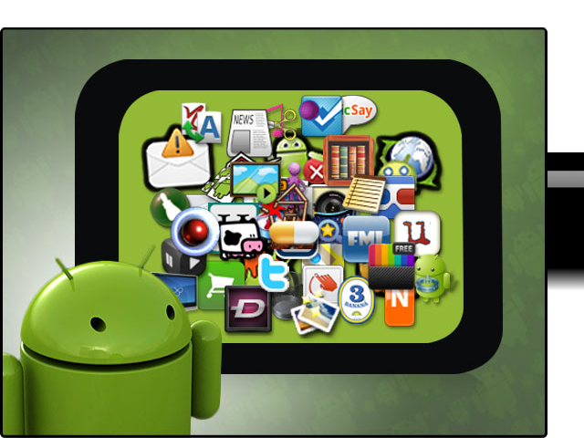
Android resources

Slide 17

Resources
Android supports the externalization of resources
  strings, colors, images,
  themes, menus, layouts
  system resources
Why?
  easier to maintain, update, and manage
  easier to define alternative resource values for internationalization and to support variations in hardware

Slide 18
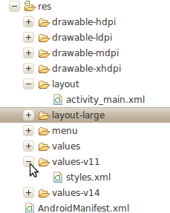
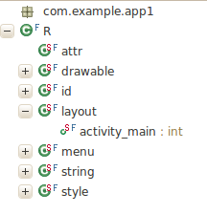
res/ & R
res/
  Generated by ADT Wizard
  Each resource type is stored in a different subfolder
R.java
  Resources from /res are „indexed“ by ADT or aapt tool
  Enables to reference resources in code

Slide 19
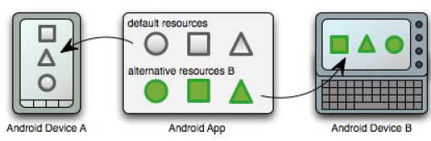
Default v. Alternative Resources
For any type of resource, we can specify default and multiple alternative resources
Default resources are used regardless of the device configuration when no alternative resources match the current configuration
Alternative resources are designed for use with a specific configuration

Slide 20
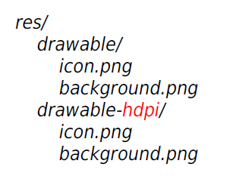
How to specify Alternative Resources
Create a new directory in res/
  res/<resources_type>-<config_qualifier>
<config_qualifier> specifies a configuration for which these resources are to be used
Save your alternative resources in new directory and name it as the default resource files

Slide 21
Configuration qualifiers
Control how the system selects your alternative resources based on the characteristics of the current device screen
Mobile country code | mcc310, mcc310-mnc004
Language and region | en, fr, en-rUS, fr-rFR, fr-rCA
Smallest Screen Width Available Screen Width Available Screen Height | sw600dp, sw320dp w600dp, w320dp h720dp, h480dp * Android >3.0
Screen size | small, normal, large, xlarge
Orientation | land, port
Screen density | ldpi, mdpi, hdpi, nodpi
...

Slide 22
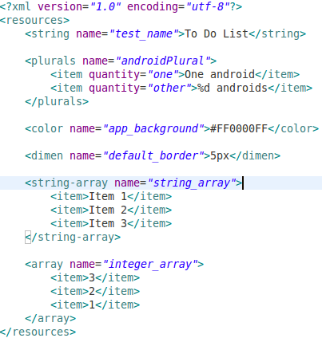
Resource types
Simple values
  Strings
  Colors
  Dimensions
  Styles
  String or integer arrays
  Stored within XML files in the res/values folder

Slide 23
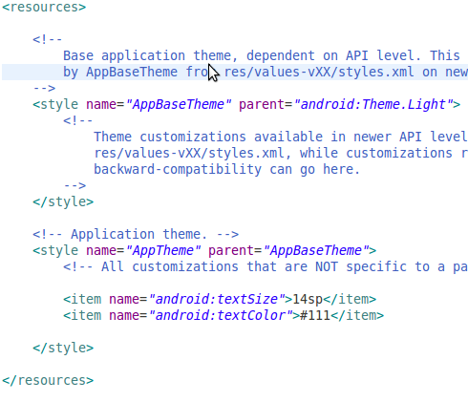
Resource types
Styles and Themes
  Let your applications maintain a consistent look and feel by enabling you to specify the attribute values used by Views
  The most common use of is to store the colors and fonts for an application

Slide 24
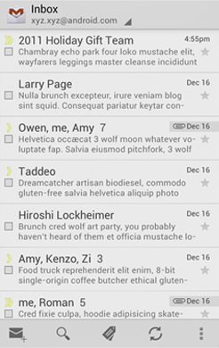
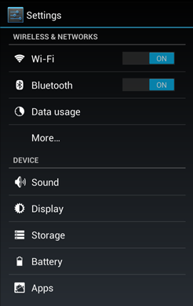
Themes
Themes are Android's mechanism for applying a consistent style to an app or activity
  visual properties of the elements of user interface, such as color, height, padding and font size
Three system themes
  Holo Light
  Holo Dark
  Holo Light with dark action bars

Slide 25
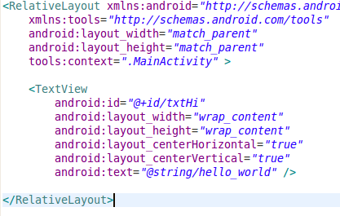
Resource types
Layouts
  Construct screens in XML
  Decouple layout from code
  Optimized layouts
  Layouts define the UI for any visual component, including Activities, Fragments, and Widgets

Slide 26
Accessing Resources
In Code - pass the resource ID as a method parameter
  setContentView(
  R.layout.main_screen);
  msgTextView = (TextView) findViewById(R.id.msg);
  msgTextView.setText(
  R.string.hello_message;
In XML - define values for some XML attributes and elements using a reference to an existing resource
<Button
android:layout_width=
"fill_parent"
android:layout_height=
"wrap_content"
android:text=
"@string/submit"/>

Slide 27

Localization
Application should handle text, audio files, numbers, currency, and graphics in ways appropriate to the locales where your application will be used
Use Android resource framework to separate localized aspects of your application from the code
  create Default Resources
  put language-specific resources to
  res/values-<language-code>/strings.xml

Slide 28
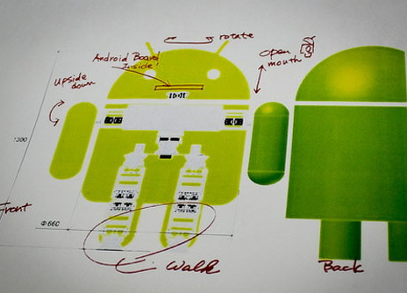
Building User Interfaces

Slide 29
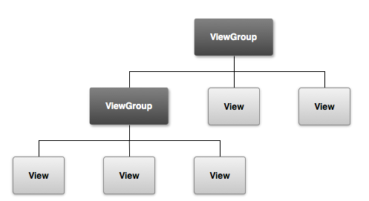
View
View
    base class for all visual interface elements controls, widgets
    an object that draws something on the screen that the user can interact with
View Group
    extends View class
    an object that holds other Views
View group is an invisible container that organizes child views, while the child views draw some part of the UI

Slide 30
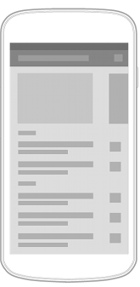
Layout
  Defines the visual structure for a user interface, such as the UI for an activity or app widget.
  Options to declare a Layout
    Declare UI elements in XML (preferred)
    Instantiate layout elements at runtime (programmatically in Java code)
    both options

Slide 31
Layout
Advantages of declaring UI in XML
  Separation of the presentation from the code that controls its behavior
    modify UI without having to modify source code
    create XML layouts for different screen orientations, different device screen sizes, and different languages
  Easier to visualize the structure of your UI
    Easier to design/debug UI
    Visualizer tool (ADT)

Slide 32
Attributes
View and ViewGroup element attributes
  View specific
  Common to all View elements
  Layout parameters, describe layout orientations of the View element
ID attribute (android:id="@+id/element")
  Any View object may have an integer ID associated with it, to uniquely identify the View within the tree

Slide 33
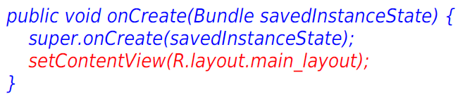
Layout file structure
Hierarchical tree structure of ViewGroups and Views
Contain one root element, either
  ViewGroup element (e.g., LinearLayout)
  View element (e.g. Button)
Layout resource is loaded in Activity

Slide 34
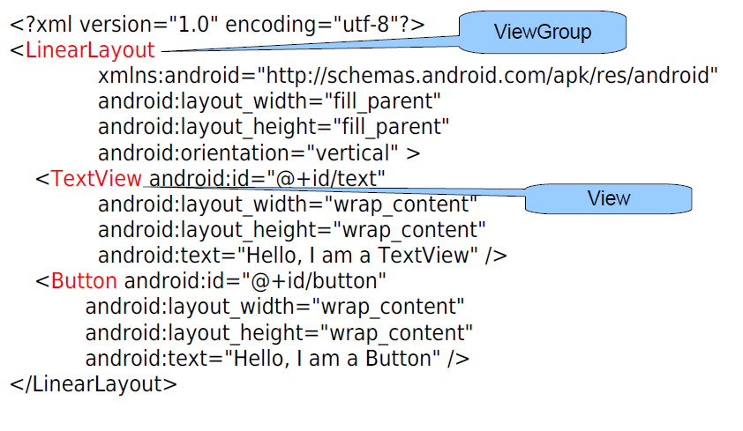
Layout File Structure

Slide 35

Layout Types
LinearLayout
  Aligns all children in a single direction - vertically or horizontally
  All children are stacked one after the other
  Layout weight (android:layout_weight) assigns an "importance" value to a view in terms of how much space is should occupy on the screen
FrameLayout
  simplest type of layout object
  a blank space on your screen that you can later fill with a single object
  child elements are pinned to the top left corner

Slide 36
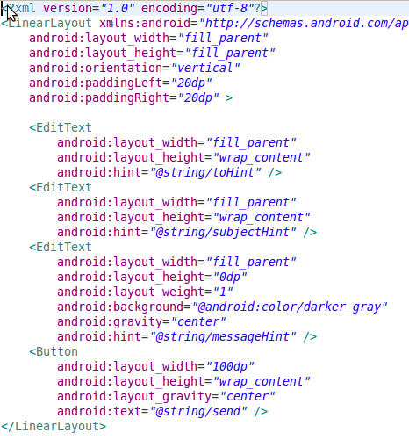
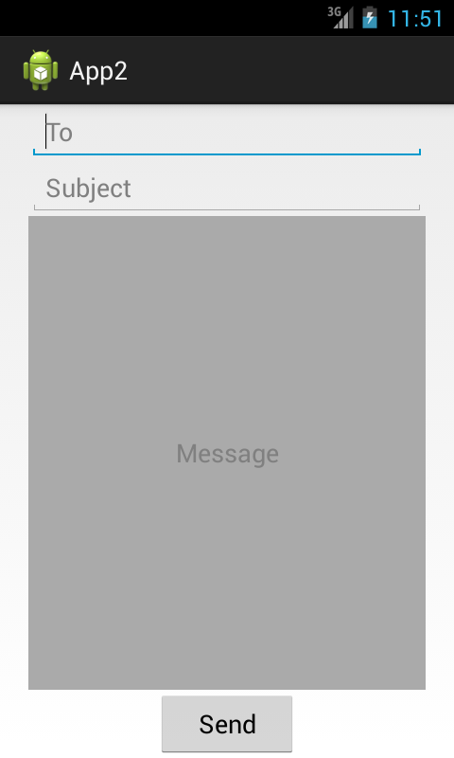
LinearLayout

Slide 37

Layout types
RelativeLayout
  view group that displays child views in relative positions
  can eliminate nested view groups and keep your layout hierarchy flat, that improves performance
  specify the location of child objects relative to each other (child A to the left of child B)
  or to the parent

Slide 38
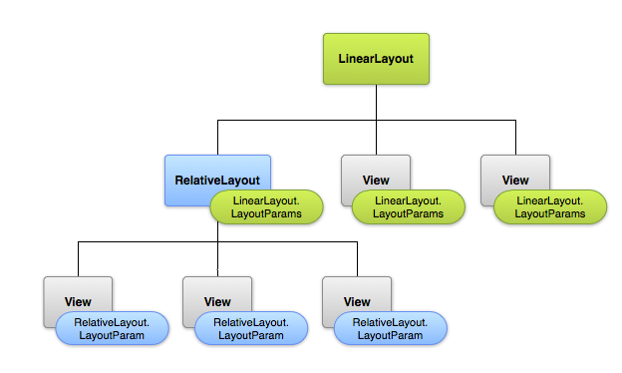
Layout types
Layout Parameters (layout_something)
  parent view group defines layout parameters for each child view (including the child view group)
  child element must define LayoutParams that are appropriate for its parent

Slide 39
Layout types
RelativeLayout.LayoutParams
  android:layout_alignParentTop - top edge of this view match the top edge of the parent
  android:layout_centerVertical - centers this child vertically within its parent.
  android:layout_below - put top edge of this view below the view specified
  android:layout_toRightOf - put left edge of this view to the right of the view specified

Slide 40
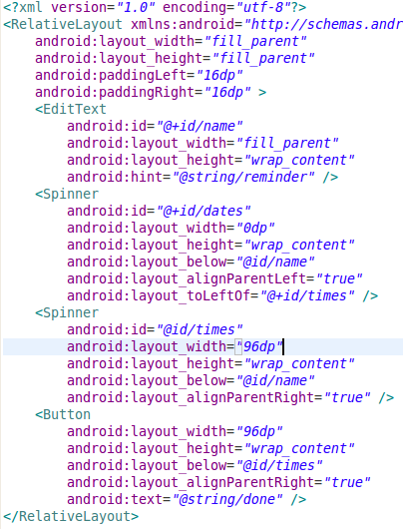
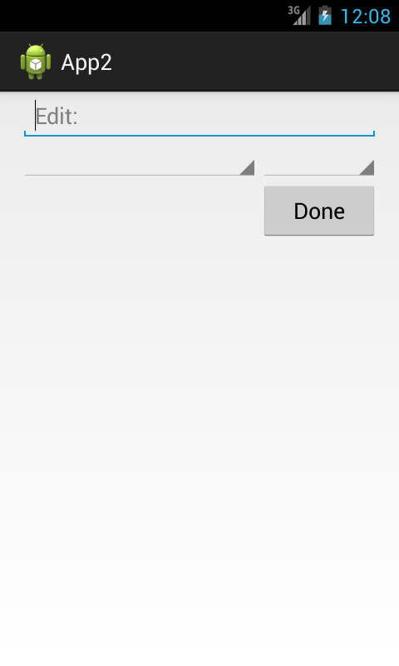
RelativeLayout

Slide 41

Optimizing Layouts
inflating layouts is an expensive process
keep your layouts as simple as possible
good practice to restrict nesting to 10 levels
use Lint tool to analyze your layouts
use “Merge” and “Include” tags
  when a layout containing a merge tag is added to another layout, its child Views are added directly to the new parent

Slide 42
Basic widget toolbox
Button, ImageButton | A push-button that can be pressed, or clicked
EditText, AutoCompleteTextView | An editable text field. AutoCompleteTextView provides auto-complete suggestions
CheckBox | An on/off switch that can be toggled by the user.
RadioGroup RadioButton | Similar to checkboxes, except that only one option can be selected in the group.
ToggleButton | An on/off button with a light indicator.
Spinner | A drop-down list that allows users to select one value from a set.
DatePicker, TimePicker | A dialog for users to select a single value for a set by using up/down buttons or via a swipe gesture.

Slide 43
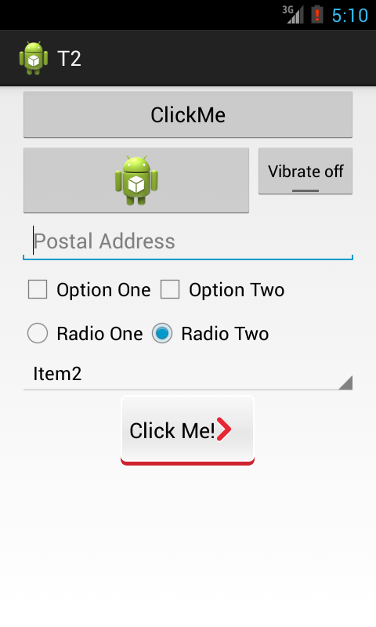

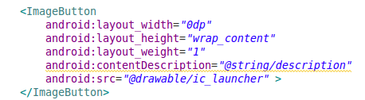
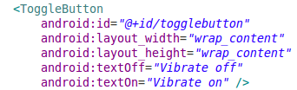
Basic widget toolbox. Buttons

Slide 44
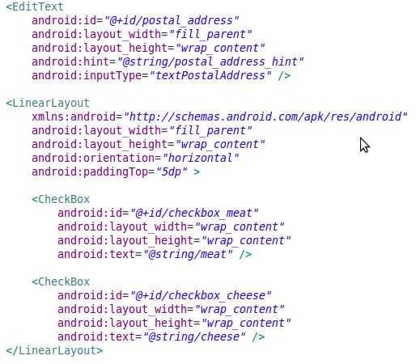
Basic widget toolbox. Inputs

Slide 45
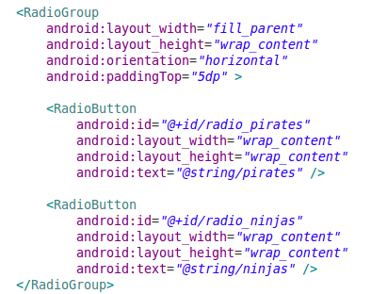
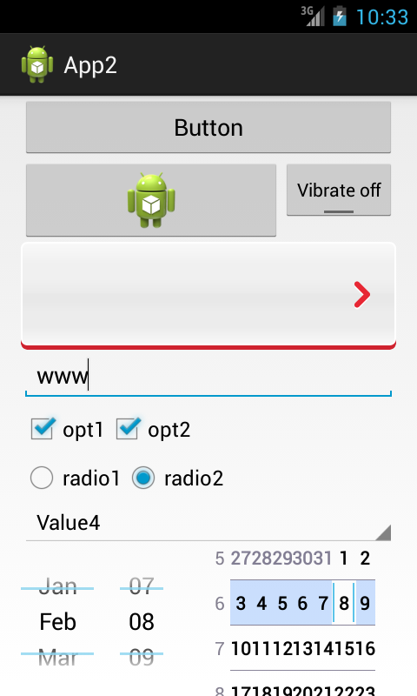
Basic widget toolbox. Inputs

Slide 46
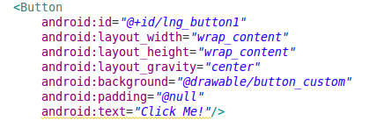
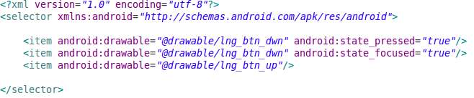


Basic widget toolbox. Custom button

Slide 47
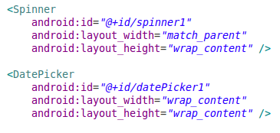
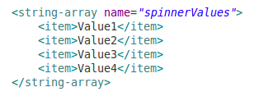
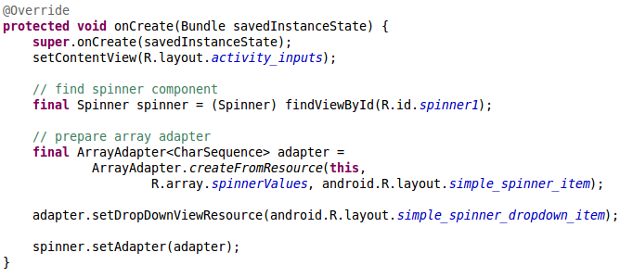
Basic widget toolbox. Spinner

Slide 48
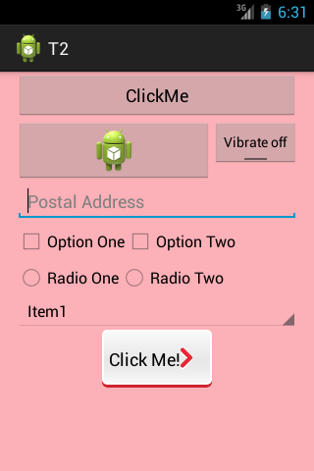
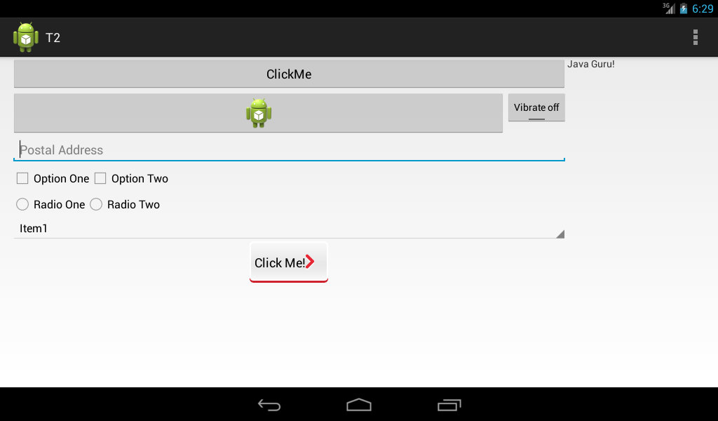
Practical task
Prepare 3 different AVD configurations
    Phone - 320x480 (HVGA), 3.2", 160dpi
    Tablet - 1024x600 (WSVGA), 7", 160dpi
    Nexus - 480x800 (WVGA), 4.0", 240dpi
Create application with screen layout consisting of basic widgets (like in slides). On tablet additional section on right with banner "Java Guru" should appear. NB! Respect layout reuse.

Slide 49

Practical task
Add custom button with provided background images (up and down states). NB! Consider density and image correct scaling (use draw9patch took if needed).
Fill Spinner with some values using string array resource and localize application for LV.
Draw layout that looks like provided.

